Slide 1
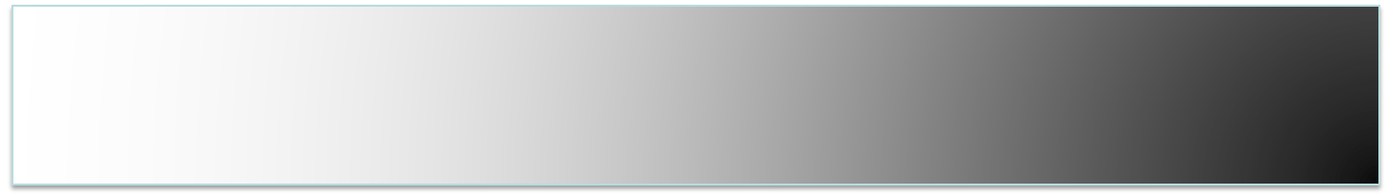
Step-by-step install of Ubuntu Operating system

Slide 2
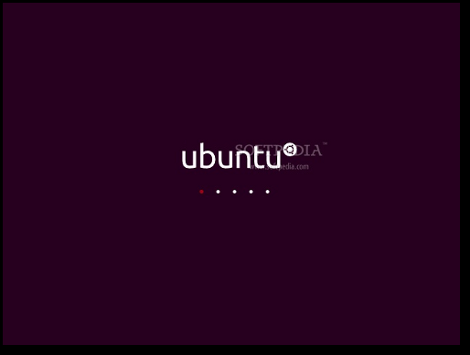
Step 1: Insert UBUNTU CD in your CD/DVD-ROM device and reboot the computer in order to boot from the CD. Hit the F8, F11 or F12 key (depending on your BIOS) to select the CD/DVD-ROM as the boot device.
Wait for the CD to load...

Slide 3
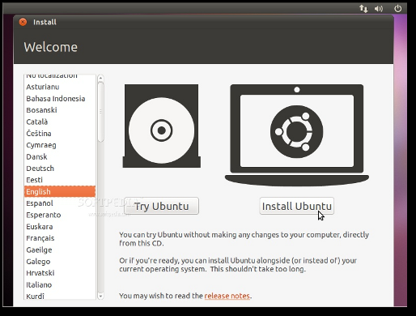
Step 2: In a couple of minutes you will see the wallpaper and the installation wizard. Select your language and click the "Install Ubuntu" button to continue...

Slide 4
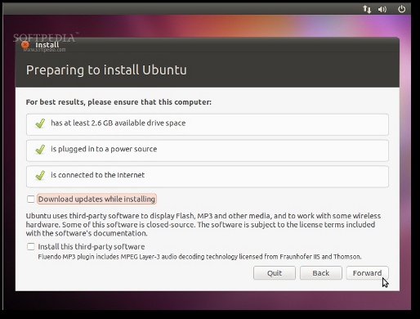
Step 3: Preparing to install Ubuntu
Make sure you have all the listed requirements.

Slide 5
Step 4: Allocate drive space
At this screen you have three options:
1. Install alongside other operating systems
- Choose this option ONLY if you have another OS (e.g. Windows XP) and you want a dual boot system.
2. Erase and use the entire disk
- Choose this option if you want to delete your existing operating system, or the hard drive is already empty and you want to let the installer automatically partition the hard drive for you. This is the option recommended for all users, especially those who want a machine with a single operating system on it.
3. Specify partitions manually (advanced)
- This option is recommended ONLY for advanced users, to create special partitions or format the hard drive with other file systems than the default one. But it can also be used to create a /home partition, which is very useful in case you reinstall the whole system.

Slide 6
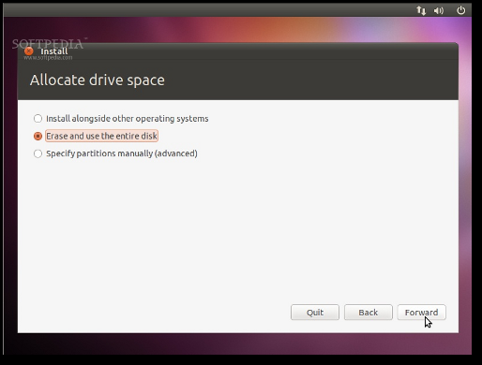

Slide 7
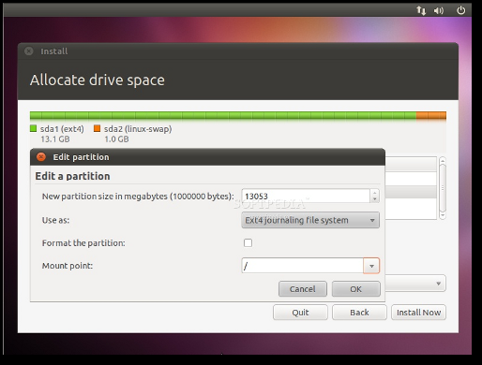

Slide 8
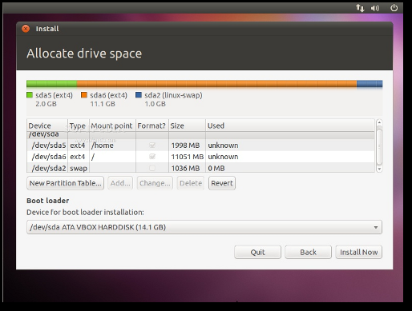
Step 5: This is how your partition table should look like...

Slide 9
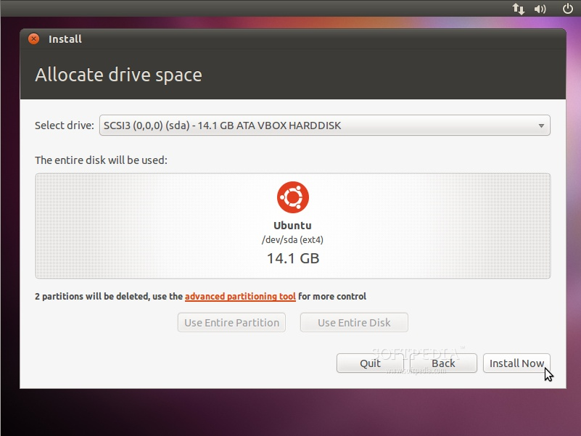
Step 6: Click the "Install Now" button to continue with the installation...

Slide 10
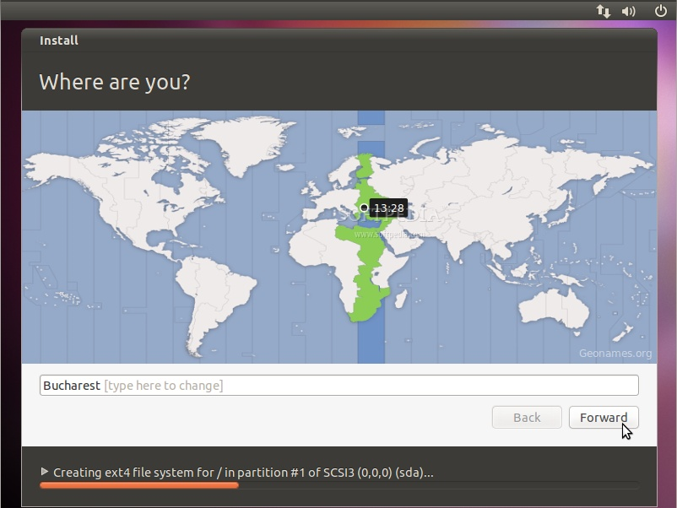
Step 8: Where are you?
This screen will feature a map of the Earth. Upon the selection of your current location, the time for the final system will adjust accordingly. You can try to guess you exact location with the mouse on the map, or just type the town in the designated field. Click the "Forward" button after you have selected your desired location...

Slide 11
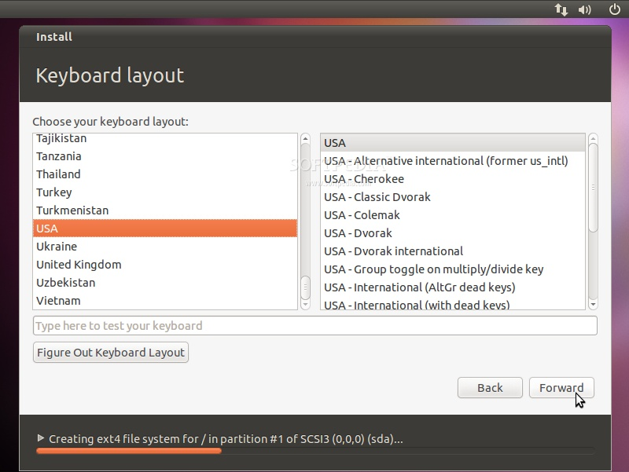
Step 9: Keyboard layout
On this screen, you will be able to choose a desired keyboard layout. But the default automatic selection should work for most of you. You can also click the "Figure Out Keyboard Layout" button for better recognition of your keyboard's layout. Click the "Forward" button when you have finished with the keyboard configuration...

Slide 12
Step 10: Who are you?
→ On this screen, you must do exactly what the title says. Fill in the fields with your real name, the name of the computer , the name you want to use to log in on your Ubuntu OS (also known as the "username," which will be required to log in to the system), and the password.
→ Also at this step, there's an option called "Log in automatically." If you check it, you will automatically be logged in to the Ubuntu desktop.
→ Other option, called “Required my password to login,“ then Click the "Forward" button to continue...

Slide 13
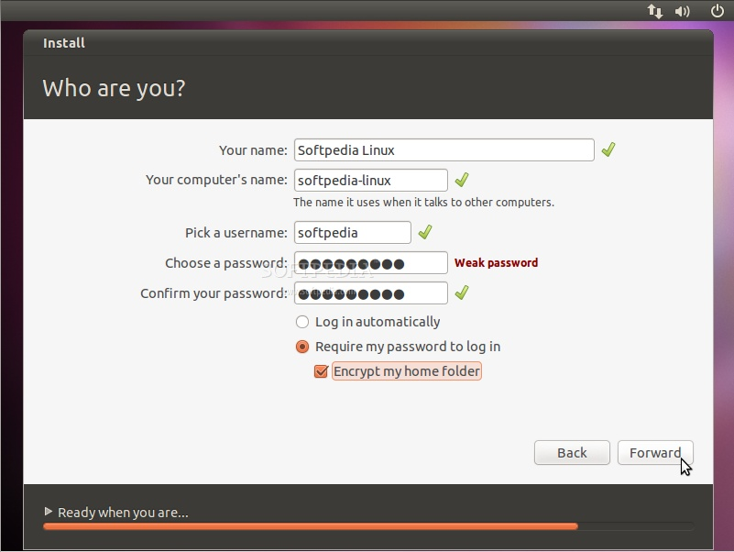

Slide 14
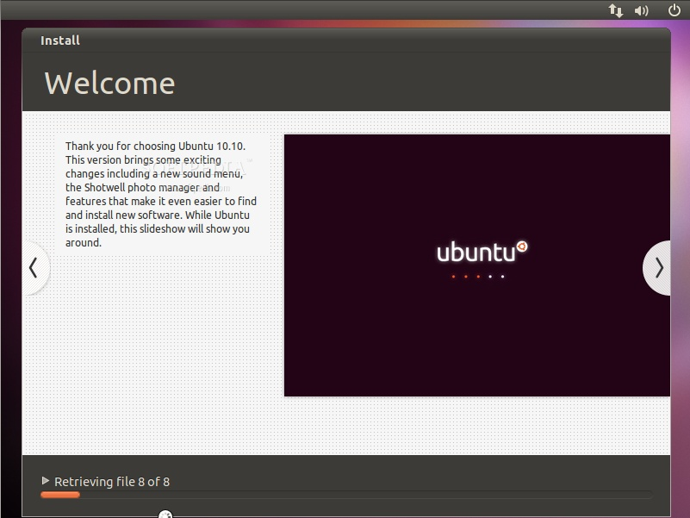
Step 11: At this point the Ubuntu 10.10 Operating system will be installed...

Slide 15
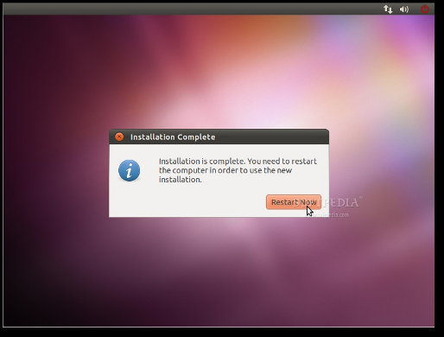
Step 12: After approximately 10 to 15 minutes (depending on your computer's specs), a pop-up window will appear, notifying you that the installation is complete, and you'll need to restart the computer in order to use the newly installed Ubuntu operating system. Click the "Restart Now" button...

Slide 16
Step 13: The CD will be ejected; remove it and press the "Enter" key to reboot. The computer will be restarted and, in a few seconds, you will see the Ubuntu boot splash...

Slide 17
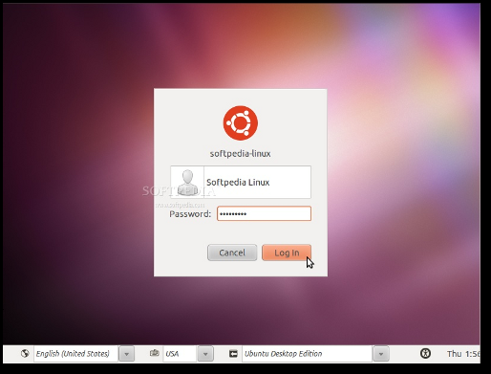
Step 14: At the login screen, click on your username and input your password. Click the "Log In" button or hit Enter to log in...

Slide 18
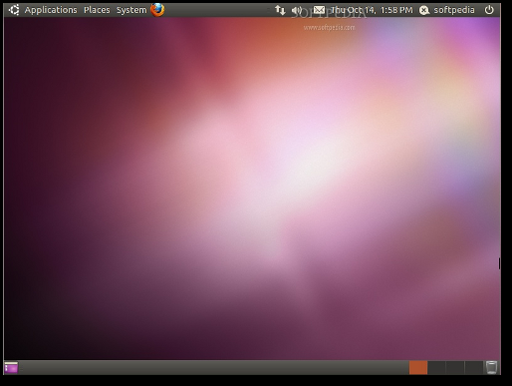
Step 15: That it! Have fun using Ubuntu

